Slide 1

CS654: Digital Image Analysis
Lecture 38: Texture and Histogram Features

Slide 2
Recap of Lecture 37
Distance metric
Interest point detector
Feature descriptor

Slide 3
Outline of Lecture 38
Texture
Histogram based Feature
BOVW
VLAD

Slide 4
What is texture ?
There is no accurate definition.
It is often used to represent all the “details” in the image.
Sometimes images are divided to shape + texture.
Images or patterns with some kind of “structure”.

Slide 5
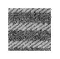
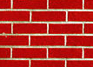


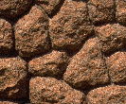
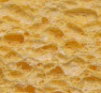
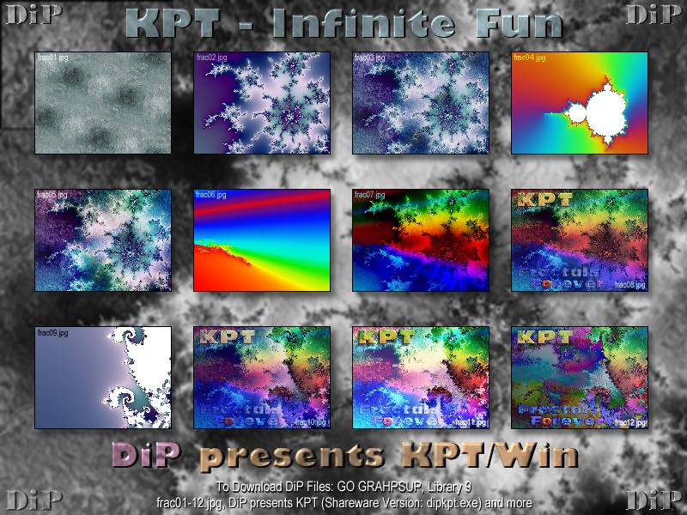
Texture examples
Repetition
Stochastic
Both
Fractal

Slide 6
What would we like to do with textures?
Detect regions / images with textures.
Classify using texture.
Segmentation: divide the image into regions with uniform texture.
Synthesis – given a sample of the texture, generate random images with the same texture.
Compression (Especially fractals)

Slide 7
Texture primitives
The basic elements that form the texture.
Sometimes, they are called “texels”.
Primitives do not always exists ( or are not visible).
In textures which are not periodic, the texel is the “essential” size of the texture.
There might be textures with structure in several resolutions (bricks)
Fractals have the similar structure in each resolution.

Slide 8
Statistical Texture Measures
1. Edge Density and Direction
Use an edge detector as the first step in texture analysis.
The number of edge pixels in a fixed-size region tells us
how busy that region is.
The directions of the edges also help characterize the texture

Slide 9
Two Edge-based Texture Measures
1. Edgeness per unit area
2. Edge magnitude and direction histograms
Fedgeness = |{ p | gradient_magnitude(p) ≥ threshold}| / N
where N is the size of the unit area
Fmagdir = ( Hmagnitude, Hdirection )
where these are the normalized histograms of gradient
magnitudes and gradient directions, respectively.

Slide 10
Local Binary Pattern (LBP)
For each pixel p, create an 8-bit number
b1 b2 b3 b4 b5 b6 b7 b8
where bi = 0 if neighbor i has value less than or equal to p’s value and 1 otherwise.
Represent the texture in the image (or a region) by the
histogram of these numbers.
1 2 3
100 101 103
40 50 80
50 60 90
4
5
8
1 1 1 1 1 1 0 0
7 6

Slide 11
Co-occurrence Matrix Features
A co-occurrence matrix is a 2D array C in which
Both the rows and columns represent a set of possible
image values.
C (i,j) indicates how many times value i co-occurs with
value j in a particular spatial relationship d.
The spatial relationship is specified by a vector d = (dr,dc).
d

Slide 12
Second order statistics (or co-occurrence matrices)
Matrix of frequencies at which two pixels, separated by a certain vector, occur in the image.
0 1 2 3
Example:
Co-occurrence matrix of I(x,y) and I(x+1,y)
Normalize the matrix to get probabilities.
0
1
2
3

Slide 13
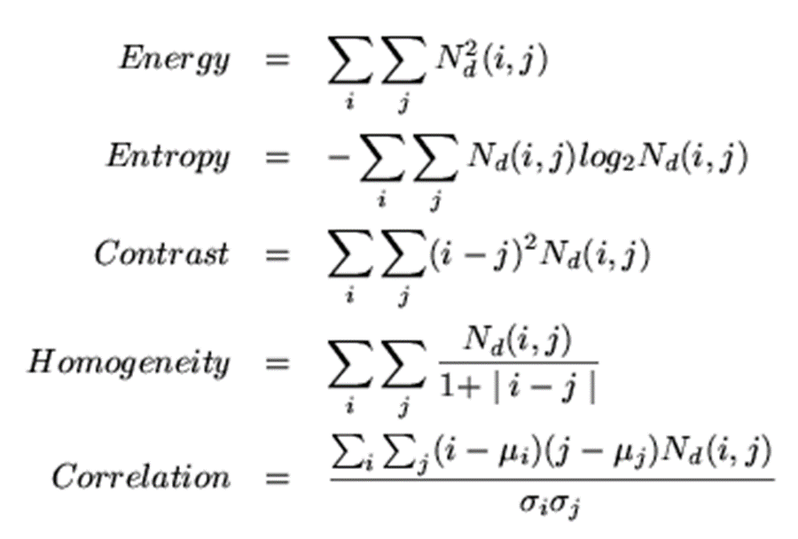
Co-occurrence Features
What do these measure?
Energy measures uniformity of the normalized matrix.

Slide 14

Problems: semantic gap
Objects
(regions)
semantics
Texture
(local regions)
Levels of image content
semantic gap
Color, brightness
(one pixel)
low-level features
How to understand what’s on the images?

Slide 15

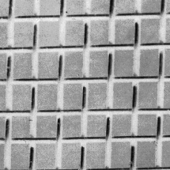
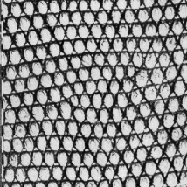



Origin 1: Texture recognition
Texture is characterized by the repetition of basic elements or textons
For stochastic textures, it is the identity of the textons, not their spatial arrangement, that matters
Julesz, 1981; Cula & Dana, 2001; Leung & Malik 2001; Mori, Belongie & Malik, 2001; Schmid 2001; Varma & Zisserman, 2002, 2003; Lazebnik, Schmid & Ponce, 2003

Slide 16




Origin 1: Texture recognition
histogram
Universal texton dictionary
Julesz, 1981; Cula & Dana, 2001; Leung & Malik 2001; Mori, Belongie & Malik, 2001; Schmid 2001; Varma & Zisserman, 2002, 2003; Lazebnik, Schmid & Ponce, 2003

Slide 17
Origin 2: Bag-of-words models
Orderless document representation: frequencies of words from a dictionary Salton & McGill (1983)

Slide 18
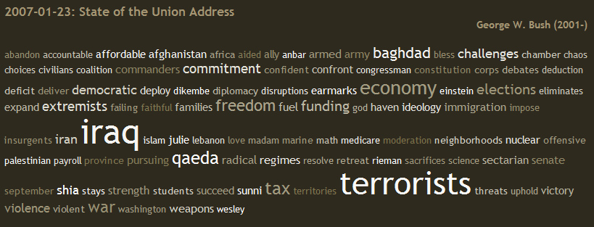
Origin 2: Bag-of-words models
Orderless document representation: frequencies of words from a dictionary Salton & McGill (1983)
US Presidential Speeches Tag Cloud http://chir.ag/phernalia/preztags/

Slide 19
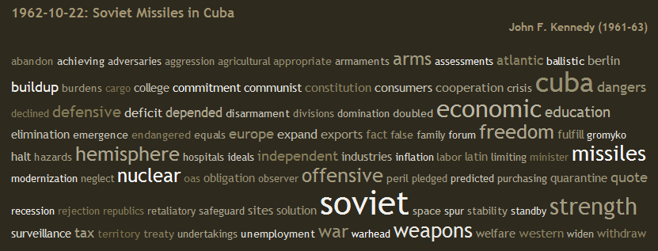
Origin 2: Bag-of-words models
Orderless document representation: frequencies of words from a dictionary Salton & McGill (1983)
US Presidential Speeches Tag Cloud http://chir.ag/phernalia/preztags/

Slide 20
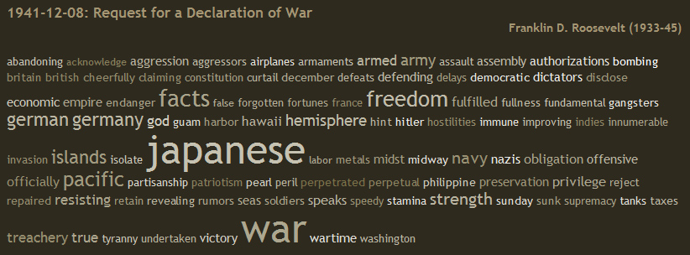
Origin 2: Bag-of-words models
Orderless document representation: frequencies of words from a dictionary Salton & McGill (1983)
US Presidential Speeches Tag Cloud http://chir.ag/phernalia/preztags/

Slide 21
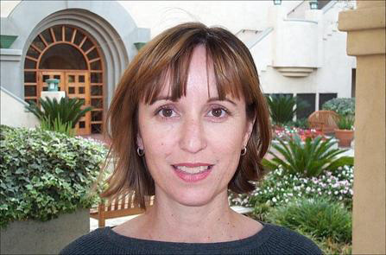
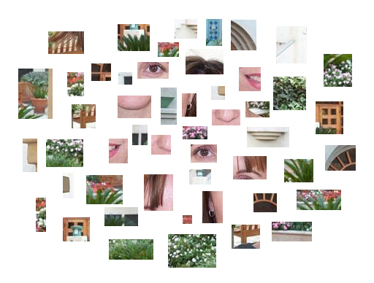
Bags of features for object recognition
Works pretty well for image-level classification
Face, flowers, building
Csurka et al. (2004), Willamowski et al. (2005), Grauman & Darrell (2005), Sivic et al. (2003, 2005)

Slide 22
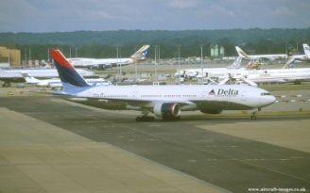
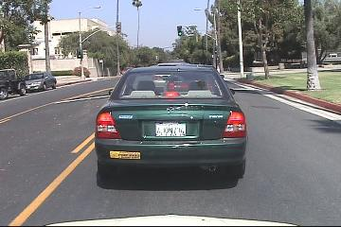
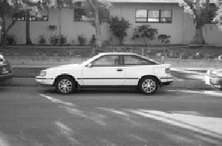
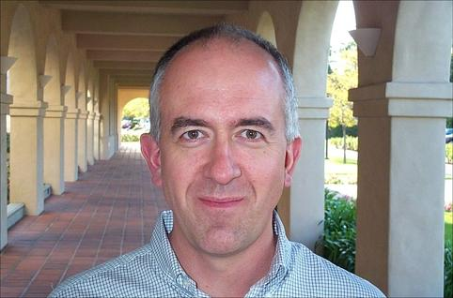
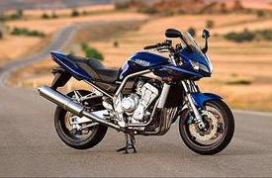
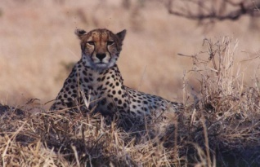
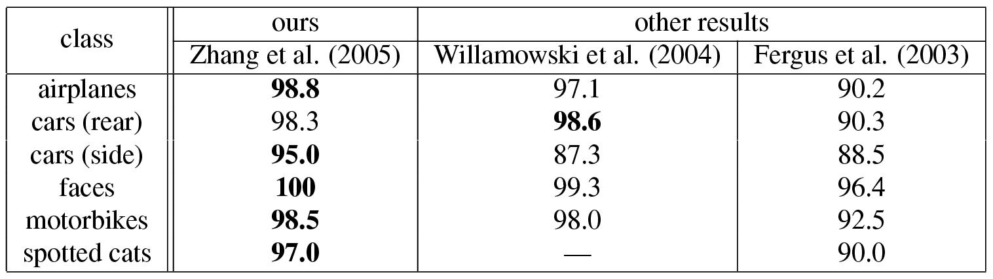
Bags of features for object recognition
Caltech6 dataset
bag of features
bag of features
Parts-and-shape model

Slide 23
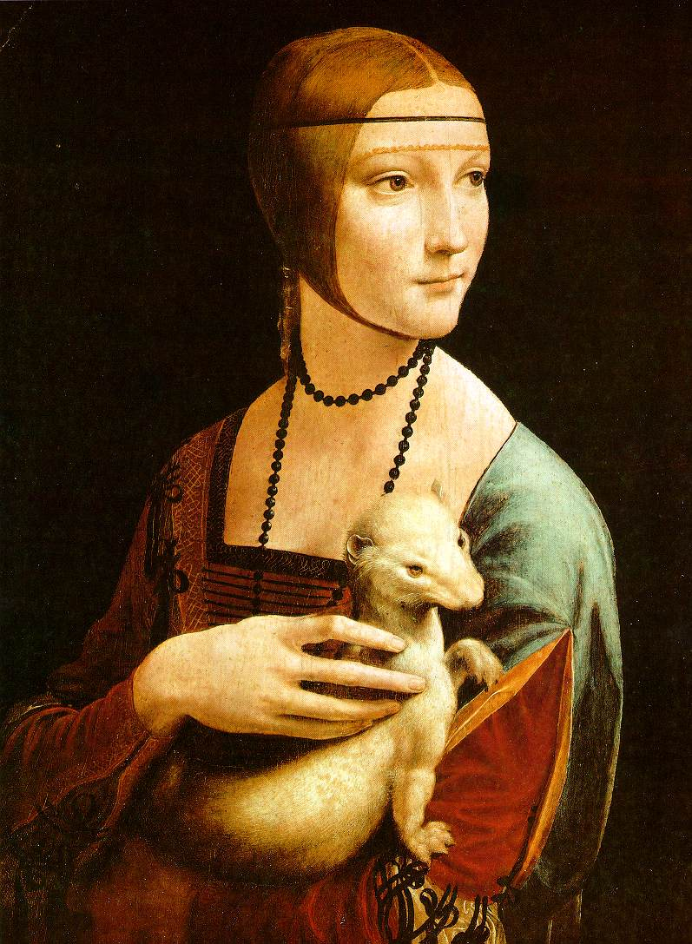
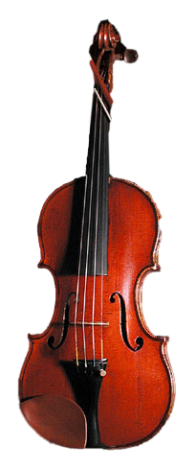
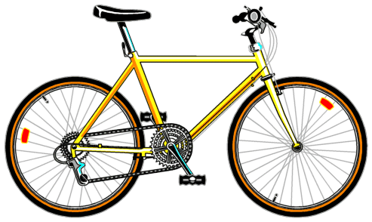
Bag of features: outline
Extract features

Slide 24
Bag of features: outline
Extract features
Learn “visual vocabulary”

Slide 25
Bag of features: outline
Extract features
Learn “visual vocabulary”
Quantize features using visual vocabulary

Slide 26
Bag of features: outline
Extract features
Learn “visual vocabulary”
Quantize features using visual vocabulary
Represent images by frequencies of “visual words”

Slide 27
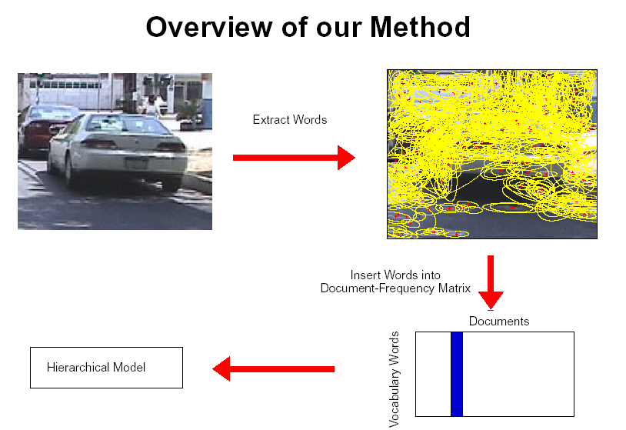
1. Feature extraction
Regular grid
Vogel & Schiele, 2003
Fei-Fei & Perona, 2005

Slide 28
1. Feature extraction
Regular grid
Vogel & Schiele, 2003
Fei-Fei & Perona, 2005
Interest point detector
Csurka et al. 2004
Fei-Fei & Perona, 2005
Sivic et al. 2005

Slide 29
1. Feature extraction
Regular grid
Vogel & Schiele, 2003
Fei-Fei & Perona, 2005
Interest point detector
Csurka et al. 2004
Fei-Fei & Perona, 2005
Sivic et al. 2005
Other methods
Random sampling (Vidal-Naquet & Ullman, 2002)
Segmentation-based patches (Barnard et al. 2003)

Slide 30
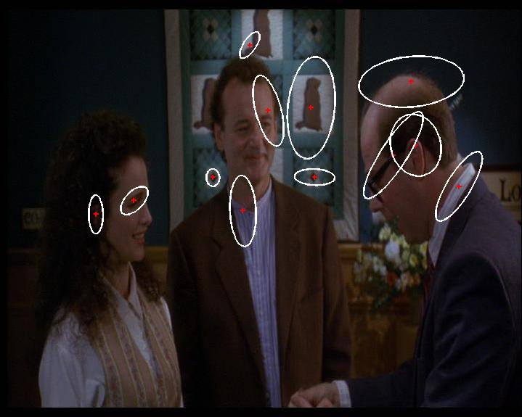
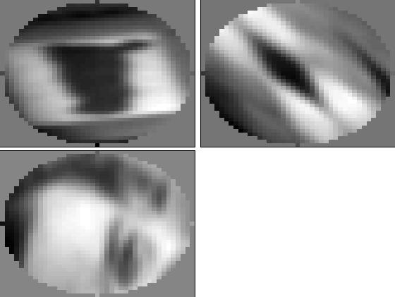
1. Feature extraction
Compute SIFT descriptor
[Lowe’99]
Normalize patch
Detect patches
[Mikojaczyk and Schmid ’02]
[Mata, Chum, Urban & Pajdla, ’02]
[Sivic & Zisserman, ’03]
Slide credit: Josef Sivic

Slide 31
1. Feature extraction
…

Slide 32
2. Learning the visual vocabulary
…

Slide 33
2. Learning the visual vocabulary
…
Clustering
Slide credit: Josef Sivic

Slide 34
2. Learning the visual vocabulary
…
Visual vocabulary
Clustering
Slide credit: Josef Sivic

Slide 35
K-means clustering
Want to minimize sum of squared Euclidean distances between points x_{i} and their nearest cluster centers m_{k}
Randomly initialize K cluster centers
Iterate until convergence:
Assign each data point to the nearest center
Re-compute each cluster center as the mean of all points assigned to it

Slide 36
From clustering to vector quantization
Clustering is a common method for learning a visual vocabulary or codebook
Unsupervised learning process
Each cluster center produced by k-means becomes a codevector
Codebook can be learned on separate training set
Provided the training set is sufficiently representative, the codebook will be “universal”
The codebook is used for quantizing features
A vector quantizer takes a feature vector and maps it to the index of the nearest codevector in a codebook
Codebook = visual vocabulary
Codevector = visual word

Slide 37
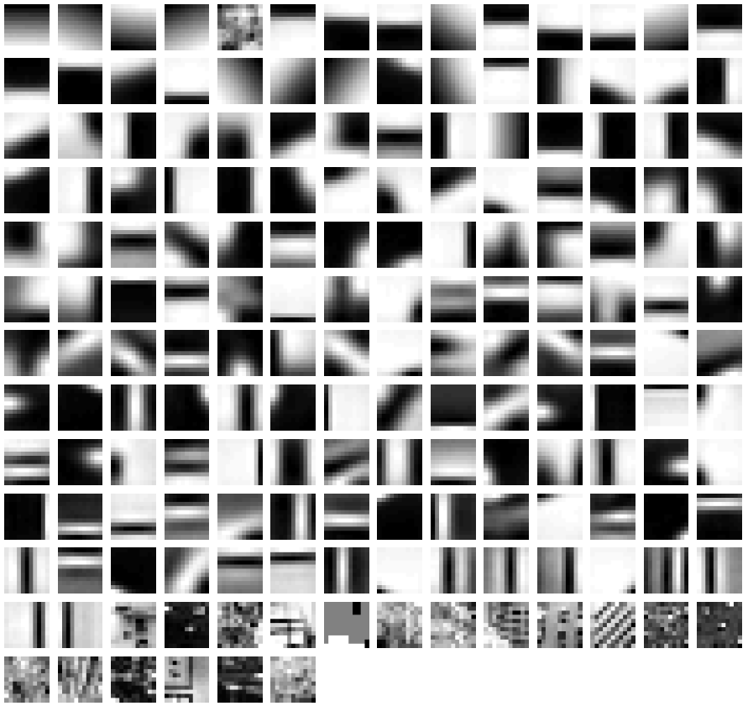
Example visual vocabulary
Fei-Fei et al. 2005

Slide 38
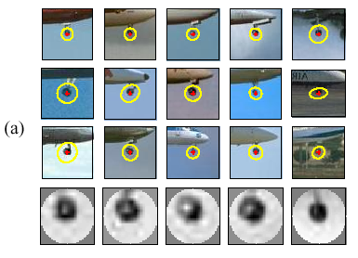
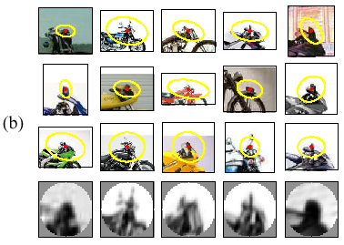
Image patch examples of visual words
Sivic et al. 2005

Slide 39
Visual vocabularies: Issues
How to choose vocabulary size?
Too small: visual words not representative of all patches
Too large: quantization artifacts, overfitting
Generative or discriminative learning?
Computational efficiency
Vocabulary trees (Nister & Stewenius, 2006)

Slide 40
3. Image representation
frequency
…..
codewords

Slide 41
Image classification
Given the bag-of-features representations of images from different classes, how do we learn a model for distinguishing them?

Slide 42
VLAD: Vector of Locally Aggregated Descriptors
BoW counts the no. of descriptors associated with each cluster in a codebook(vocabulary)
Then creates a histogram for each set of descriptors from an image
VLAD accumulate the residual of each descriptor with respect to its assigned cluster.
Stores the sum of the differences of the descriptors assigned to the cluster and the centroid of the cluster.

Slide 43
VLAD
Learning: a vector quantifier (k-means)
output: k centroids (visual words): c₁,…,c_{i},…c_{k}
centroid c_{i} has dimension d
For a given image
assign each descriptor to closest center c_{i}
accumulate (sum) descriptors per cell
v_{i} := v_{i} + (x - c_{i})
VLAD (dimension D = k x d)
The vector is L2-normalized
x
c_{i}

Slide 44
Thank you

